Slide 1

Page Setup
Set up the first page of every lesson like this and rule a column line for every page after the first page that is used during the lesson.
Focus: State the Chapter Number, Title and the page numbers (3 lines).
Keywords: During the lesson write out your own keywords used during the lesson. (8 lines)
Context: During the lesson write in this section what this topic relates to in the ‘real’ world. How is this content used to better society? (5 lines)

Slide 2

Electrical Charge
Chapter 5.1 page 140-146

Slide 3
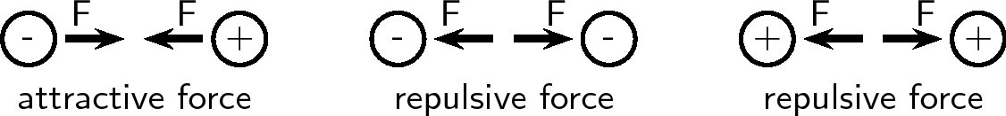
Charges
In brief
Like charges Repel
Unlike charges Attract
Capacitance – storage of Power
Power is the amount of energy used per unit time.
The imbalance between the number of electrons and number of protons in a local area results in a charge existing (A need to equalise by the taking or removing of electrons results in a static discharge).

Slide 4
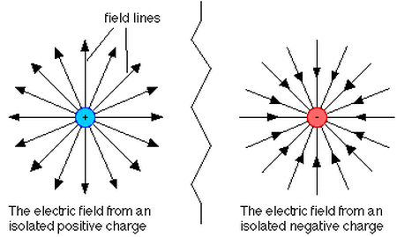
Electric Field
Field lines are representations of the forces a charge experiences.
Field lines must enter and leave at 90º to the tangent of the object.
Arrows must show field lines
entering a negative charge and
exiting a positive charge

Slide 5
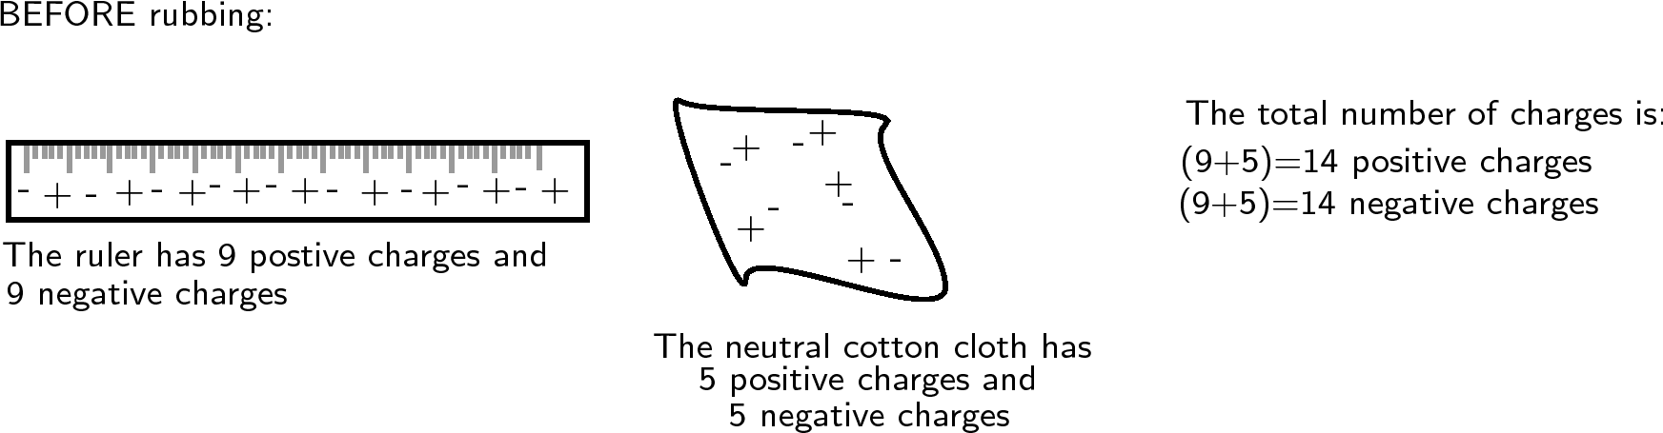
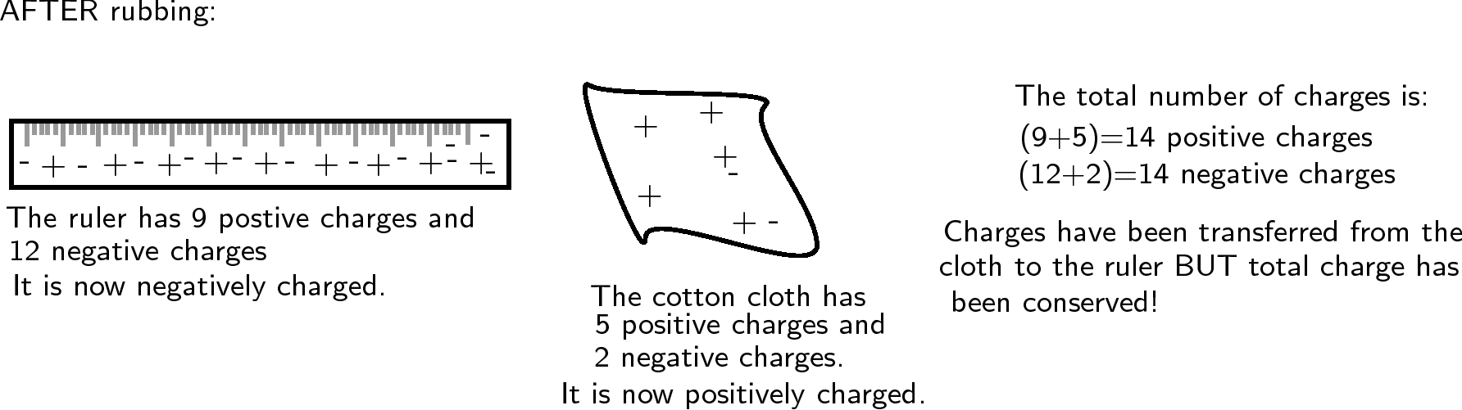
Electrostatic Charge
When two objects are rubbed together this results in electrons moving between the materials.

Slide 6
Charging By Touch
Charged objects can transfer and equally distribute their charge with other objects.
+
+
+
+
+
e⁻
+
+
+
Moves towards
neutral sphere
e⁻
+
+
+
+
+
+
+
e⁻
+
+
+
e⁻
+
+
+
+
+
e⁻
+
+
+ 10 Coulomb Charge
+ 5 Coulomb Charge
+ 5 Coulomb Charge
No Charge

Slide 7
Charge By Induction
If a negatively charged object is held close to a neutral object, the electrons on the neutral object will be repelled to the other side of the neutral object.
A way of removing the electrons from the neutral sphere is to include an earthing wire, which allows the electrons to move out of the sphere. Then the earthing wire is removed and the sphere itself becomes a positively charged object.
e⁻
+
e⁻
e⁻
e⁻
e⁻
e⁻
e⁻
+
+
e⁻
e⁻
e⁻
e⁻
+
e⁻
+

Slide 8
Measuring Charge
The nucleus contains most of the mass of an atom, but occupies the smallest part of the atoms volume.
The electrons are the significant component of an atom when discussing electrical charge. The excess or lack of electrons determines an atoms charge.
The unit of charge is measured in Coulombs (C).
1 electron has a charge of 1.602 x 10⁻¹⁹ C

Slide 9

Atomic Charge
Example 5.1a:
What is the charge (in Coulombs) carried by 6 billion electrons jumping from one rod of Perspex to a piece of cloth?
Solution
No. of atoms = 6 x 10⁹
1 electron has a charge of 1.602 x 10⁻¹⁹ C
Charge = 6 x 10⁹ x 1.602 x 10⁻¹⁹
= 9.6 x 10⁻¹⁰ C

Slide 10
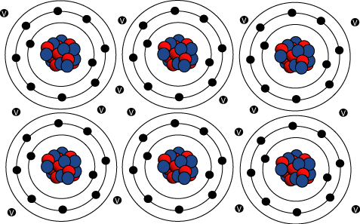
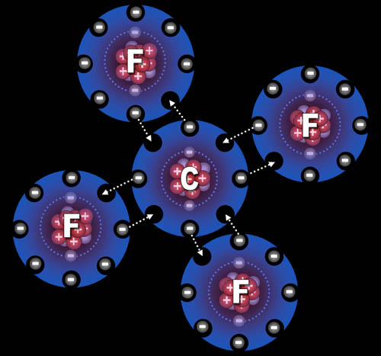
Conductors and Insulators
A conductor is something that readily allows the transfer, loss or gain of electrons.
Metal structures have free “delocalised”
electrons around a crystal lattice of nuclei.
An insulator is an object that does not readily allow its electrons to move. This is mostly because the outer shell electrons are used in the bonding process of the structure.

Slide 11
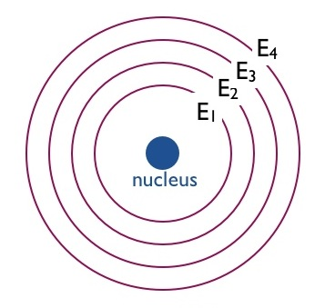
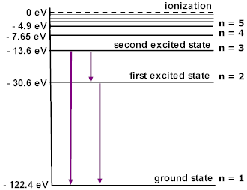
Valence & Conduction Bands
A single atom will have energy levels. Electrons fill the first energy level (E₁), then the second (E₂), etc, until no more electrons are available/needed. Those electrons at ground state have more potential energy and less kinetic energy than those electrons at higher energy levels, due to their lower orbital path.

Slide 12
Valence & Conduction Bands
Quantum hypothesis – electrons only exist in definite and discrete orbits of a particular energy (known as energy levels). However, an electron can move temporarily to a higher orbit if given enough energy.
Hydrogen atom, for example.
Energy Out
Energy In
N

Slide 13
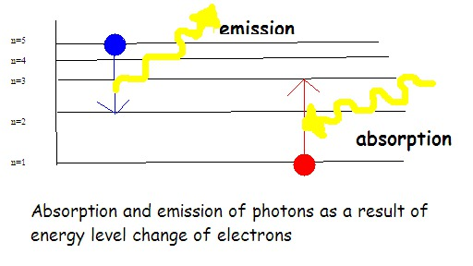
Energy Levels
Energy is absorbed when an electron moves to a higher energy level from a lower energy level.
Energy is emitted when an electron returns to a lower (more stable) energy level from a higher energy level.

Slide 14
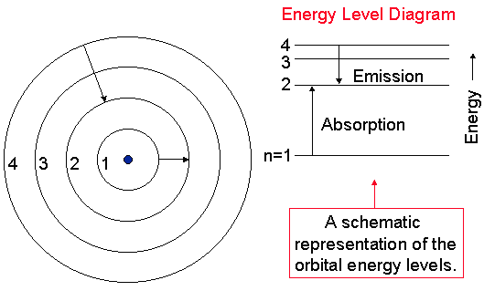
Energy Levels
Electromagnetic radiation is either absorbed or emitted by an excited atom when an electron move to or falls from a higher energy level.
The photons energy will be exactly equal to the energy difference between the electrons initial and final levels.

Slide 15
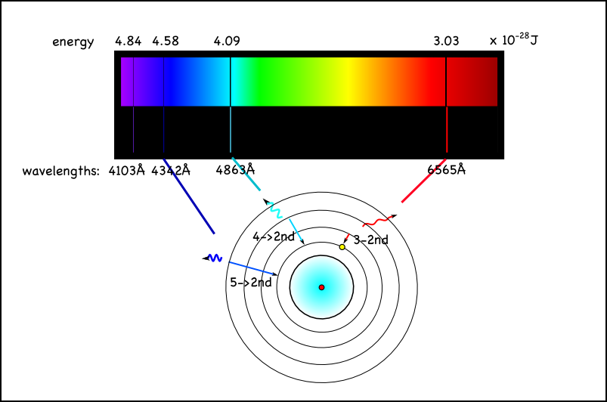
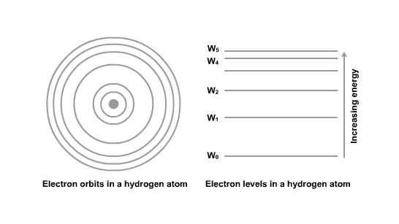
Line Emission Spectra
The energy levels are unique to each atom, and the emission energy can be recorded when released from the atom.
This is an example of a line emission diagram of hydrogen.

Slide 16
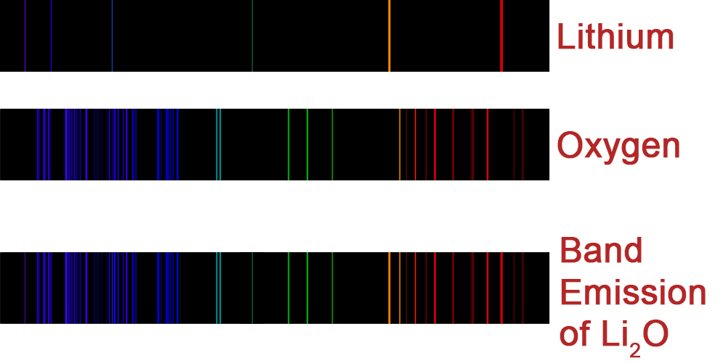
Band Emission Spectra
This is useful for determining the make-up of a compound. This is known as band emission.

Slide 17
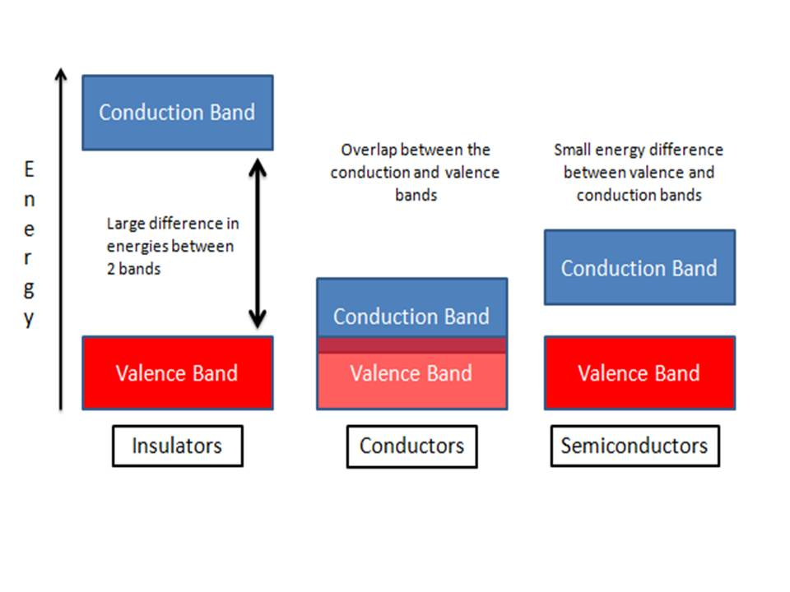
Conduction and Valence Bands
This is in conjunction with ionic, covalent and metallic bonds between atoms.
The valence electrons are bound to individual atoms, as opposed to conduction electrons (found in conductors and semiconductors), which can move freely within the atomic lattice of the material.
The valence band is located below
the conduction band. In insulators
and semiconductors there is a band
gap. In metals, the conduction band
has no energy gap separating it
from the valence band.

Slide 18
Conduction and Valence Bands
The conduction band quantifies the range of energy required to free an electron from its bond to an atom. Once freed from this bond, the electron becomes a 'delocalized electron', moving freely within the atomic lattice of the material to which the atom belongs.
In insulators, the conduction band is much higher in energy than
the valence band and it takes large energies to
delocalize their valence electrons. This usually results
in the melting and chemical alteration of the original
compound. Insulating materials have wide band gaps.

Slide 19
Conduction and Valence Bands
In semiconductors, the band gap is small. This explains why it takes
a little energy (in the form of heat or light) to make
semiconductors' electrons delocalise and conduct
electricity, hence the name, semiconductor.
In metals, the electrons within the conduction band are mobile
charge carriers in solids, responsible for conduction
of electric currents in metals and other good
electrical conductors.

Slide 20
Resistance and Insulators
The availability and the number of “free electrons” within a material greatly affects the ease with which a current will flow.
Super Conductors – some metals and ceramics have zero resistance when they are cooled to temperatures close to absolute zero. Mercury and Lead become superconducting at temperatures of 4.2 K and 7.2 K respectively.
Good Conductors – low resistance wires, suitable for electric circuits.
Poor Conductors – relatively high resistance, used for fuse wires and heat filaments.
Semi-conductors – Non-metals with relatively high resistance. The resistance can be reduced in semi-conductors by introducing specific impurities.
Insulators – Materials that have extremely high resistivity, like wood, glass and plastic.

Slide 21

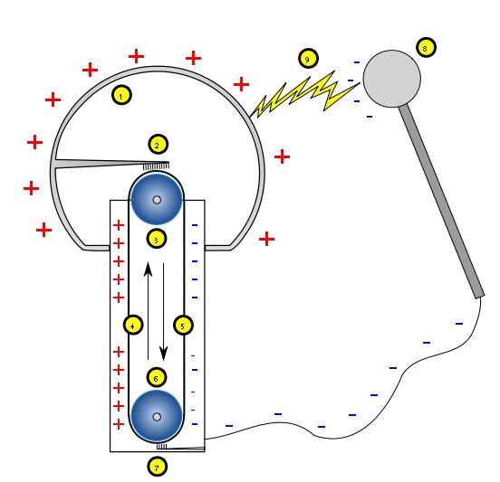
Van der Graaf Generator
The rubber belt (4) is rotated by a motor (6). Charge is picked up from the power supply and sprayed onto the belt from a brush (7). This charge is transferred off the belt and to the dome (1), through the top brush (2).

Slide 22
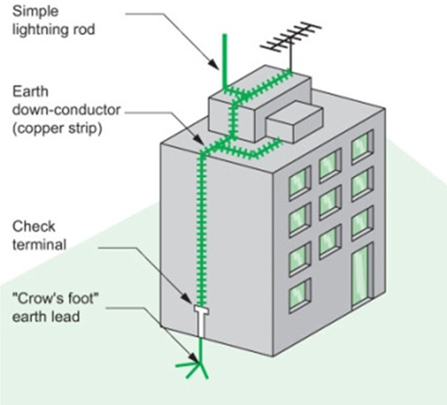
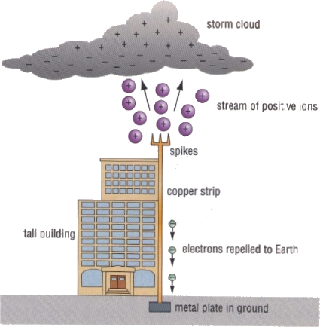
Lightning Conductor
Lightning is caused by the build up of charge on the water particles in clouds from the friction with air. The positive charge builds up on the top of the cloud and the negative underside causes the air to ionise. The ionised air acts as a conductor to allow a
stream of positive ions to travel up from the ground (positive streamer) and into the cloud mass, as well as a negative stream (step leader) to
make its way toward the Earth. If a step leader makes contact with a positive streamer, it creates a completed path for the plasma to travel on, allowing the accumulated current in the cloud to travel between the two points. This results in a lightning bolt and an explosion of air, which we call thunder.

Slide 23
Homework, Context & Keywords
Context: How is this content used to better society?
The principles behind understanding conductors and insulators can help develop materials that behave closely to superconductors and improve the development of motors and generators, or computers and transmission of information.

Slide 24
Homework, Context & Keywords
Key words:
Coulombs
Capacitance
Delocalised
Conductor
Insulator
Semi conductors
Electromagnetic
Valence Band
Conduction Band
Van de Graaf

Slide 25
Homework, Context & Keywords
Homework:
Complete all questions from Set 5.1 - due first lesson next week.
Read Chapter 5.2 & 5.3 page 146-153 and answer
Q1&2 Set 5.2 and
Q1,2&3 Set 5.3
by next lesson.

Slide 26
Page Setup
Set up the first page of every lesson like this and rule a column line for every page after the first page that is used during the lesson.
Focus: State the Chapter Number, Title and the page numbers (3 lines).
Keywords: During the lesson write out your own keywords used during the lesson. (8 lines)
Context: During the lesson write in this section what this topic relates to in the ‘real’ world. How is this content used to better society? (5 lines)

Slide 27
Energy & Flow in Circuits
Chapter 5.2 & 5.3 page 146-149 & page 149 - 153

Slide 28
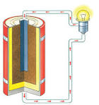
Circuit Flow
The movement of charge occurs when there is a completed circuit and that at some point on the circuit there is a cell (e.g. a battery) with an excess of charge. This charge flows around the circuit in an attempt to equalise/ neutralise the
excess charge. As the charge moves
around the circuit it can gain or lose
potential energy (such as it would
when it passes through this light bulb).

Slide 29
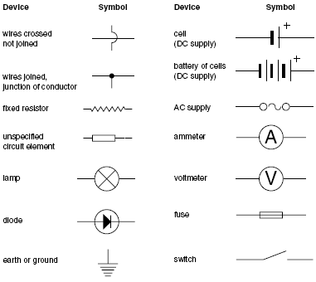
Simple Electric Circuits

Slide 30
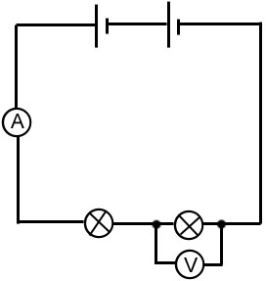
Example of Simple Circuits
List the observes components
NOTE:
1) The Voltmeter is connected either side of the light (in parallel to the light) so to measure the potential energy drop due to electricity running through the light.
2) The Ammeter must always be connected in the circuit like the lights and resistors (in series), else you will burn-out the wiring in the ammeter.
Light
Voltmeter
Ammeter
Cells
Battery
Switch
Resistor
Diode (LED)

Slide 31
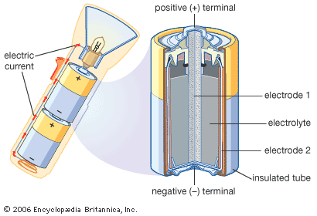
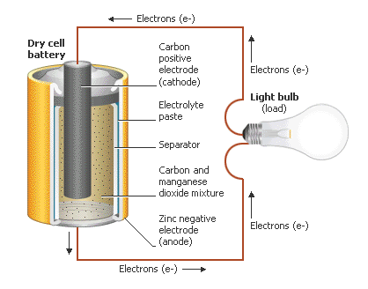
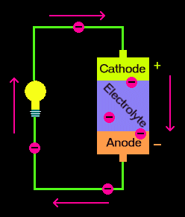
Dry Chemical Cells
The chemical energy stored in a battery is the source of the electromotive force (εMF).
Electrons flow from the location (or material) of low electronegativity (anode) to material of high electronegativity (cathode).

Slide 32
Dry Chemical Cells
The conducting material (paste/electrolyte) acts to allow electron trading through chemical reactions.
The chemical reaction occurs between the conducting material and both the low electronegative (high number of electrons) and high electronegative materials (low number of electrons).
During the process the positive and negative ions in the conducting material move to either side to increase the life of the battery.
Once the chemicals are exhausted, the battery is considered “flat”.

Slide 33
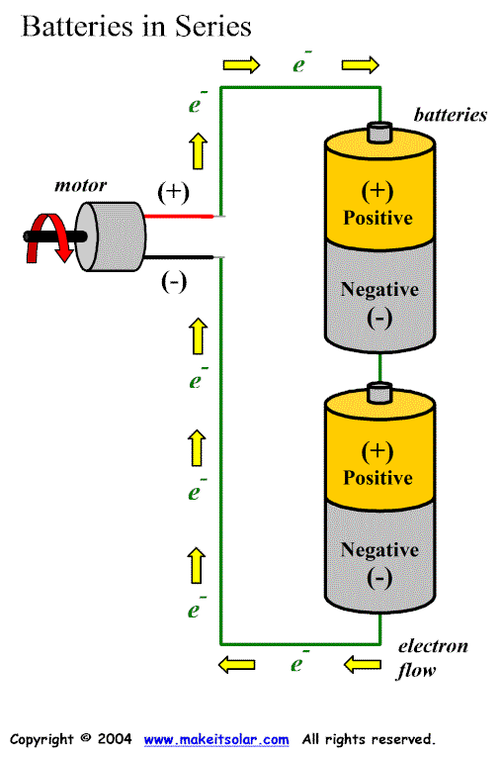
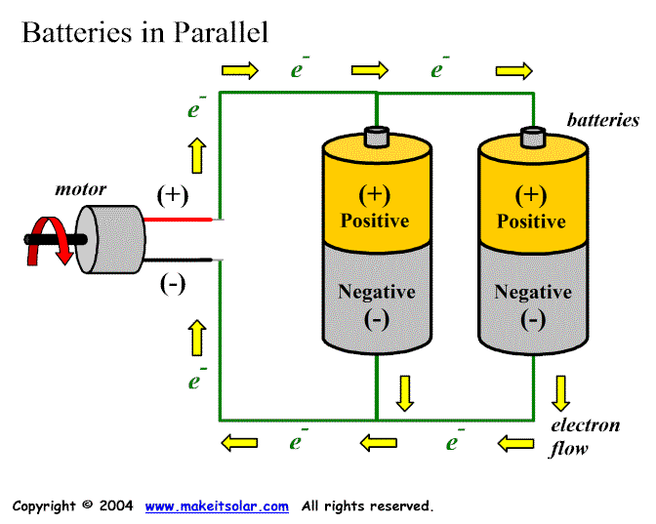
Batteries in Series and Parallel
Batteries in parallel last longer. That is, 2 full batteries in parallel will last twice as long as 2 full batteries in series.

Slide 34
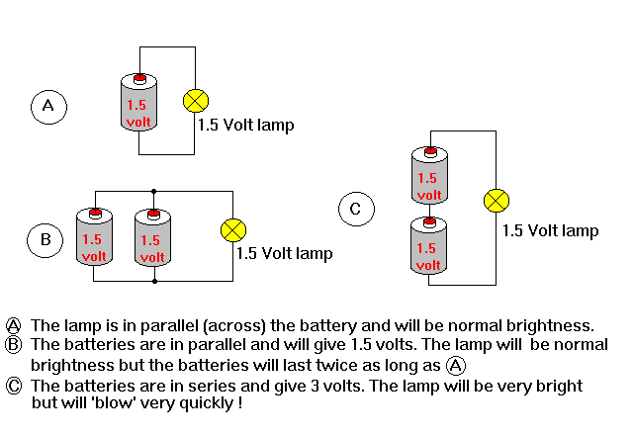
Batteries in Series and Parallel

Slide 35
Electrical Potential Difference (Voltage)
V = W
q
V – potential difference or voltage (V or J C⁻¹)
q – charge (C)
W – work (J)
Potential difference is the difference in potential energy per unit charge between two points.

Slide 36
Examples
Example 5.2a:
A CRT monitor has a potential difference in its picture tube of 3 kV across which electrons are accelerated. Calculate the energy acquired by the electrons as they are accelerated through this potential difference.
Solution
V = 3 x 10³ V
q = 1.6 x 10⁻¹⁹ C
W = V q
= 3 x 10³ x 1.6 x 10⁻¹⁹
= 4.8 x 10⁻¹⁶ J

Slide 37
Example
Example 5.2b: Electrons in a T.V. tube are accelerated through a potential difference of 2kV. Given that the mass of an electron is 9.11 x 10⁻³¹ kg and their charge is 1.6 x 10⁻¹⁹ C, determine;
a) The work done on an electron
Solution
V = 2 x 10³ V W = V q
q = 1.6 x 10⁻¹⁹ C = 2 x 10³ x 1.6 x 10⁻¹⁹
= 3.2 x 10⁻¹⁶ J
b) The Kinetic Energy of the electrons
Kinetic Energy = Work Done
= 3.2 x 10⁻¹⁶ J

Slide 38

Example
c) The final velocity of the electrons, assuming they were initially at rest.
Solution
E_{k} = 3.2 x 10⁻¹⁶J
m = 9.11 x 10⁻³¹ kg
u = 0
E_{k} = ½ m v²
v = E_{k} = 3.2 x 10⁻¹⁶
$√$ ½ m $√$ ½ x 9.11 x 10⁻³¹
v = 2.65 x 10⁷ m s⁻¹

Slide 39
Current (I)
Electric Current (I) – The amount of charge passing a given point per second. Unit of current is Ampere (A).
I = q .
t I – current (A)
q – charge (C)
t – time (s)
Example 5.3a:
A torch circuit carries a current of 2.5 x 10² mA for 3.5 minutes. Calculate the total charge the battery has lost in this time.
Solution
I = 0.25 A
t = 3.5 x 60
q = It = 0.25 x 3.5 x 60 = 52.5 C

Slide 40
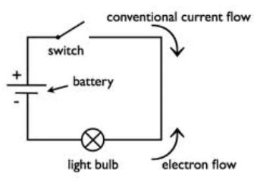
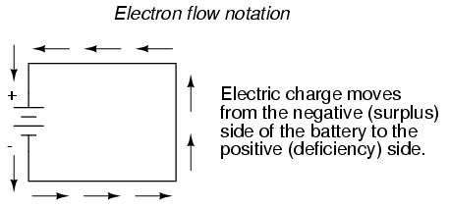
Electric Circuits
The rate of flow of electric charges, whether positive or negative is called an electric current.
Conventional Current is the flow from positive to negative.
Electron flow is from negative to positive.

Slide 41
Definitions
Conventional current – the direction of positive charge flow. Flows in the opposite direction to the flow of electrons.
Direct Current (DC) – the flow of charge is always in one direction (e.g. current from a battery).
Alternating Current (AC) – The flow of charge alternates back and forth (e.g. household supply to the power points). In Australia we run on 240 V at a frequency of 50 Hz. This means it completes one oscillation every 0.02 seconds.

Slide 42
Homework, Context & Keywords
Context: How is this content used to better society?
The principles behind understanding potential difference and current can help develop materials that behave closely to superconductors and improve the development of motors and generators, or computers and transmission of information.

Slide 43
Homework, Context & Keywords
Key words:
Current
Voltage
Charge
Potential Difference
Cells
Ammeter
Resistors
Battery

Slide 44
Homework, Context & Keywords
Homework:
Complete all questions from Set 5.2 & 5.3 - due first lesson next week.
Read Chapter 5.5 page 157-162 and answer
Q1,2&3 Set 5.5
by next lesson.

Slide 45
Page Setup
Set up the first page of every lesson like this and rule a column line for every page after the first page that is used during the lesson.
Focus: State the Chapter Number, Title and the page numbers (3 lines).
Keywords: During the lesson write out your own keywords used during the lesson. (8 lines)
Context: During the lesson write in this section what this topic relates to in the ‘real’ world. How is this content used to better society? (5 lines)

Slide 46
Resistance & Ohm’s Law
Chapter 5.5 page 157-162

Slide 47
Factors Affecting Resistance
R = ρ L .
A L – length of wire (m)
A – cross-sectional area (m²)
ρ – resistivity (Ω m)
Length – the greater the length the greater the resistance.
Cross-sectional Area – increasing area decreases resistance. E.g a thick piece of copper wire will conduct electricity easily than a thin piece.
Resistivity – is based on the nature of the conducting material (lattice arrangement, behaviour and quantity of free electrons contribute to the resistivity factor.
Temperature – this can, with some materials, affect the resistance. Usually as temperature increases, then resistance increases.

Slide 48
Ohms Law
Provided that the temperature in the circuit remains constant, the current through the resistor is proportional to the potential difference applied across it.
V = I R
V – voltage (V)
I – current (A)
R – resistance (Ω)

Slide 49
Ohmic and Non-Ohmic
Ohmic conductors are those whose resistance remains constant as the current is varied.
Examples are resistors and conducting wires within specific limits.
Non-Ohmic conductors do not show a constant relationship between voltage and current. Their resistance can increase with temperature.
Examples are diodes (LED’s), and filament light bulbs.

Slide 50
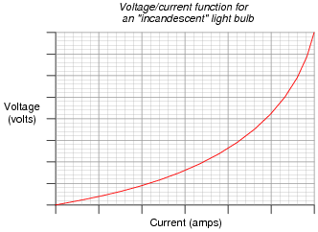
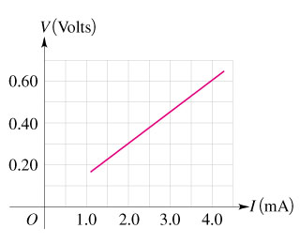
Ohmic and Non-Ohmic

Slide 51
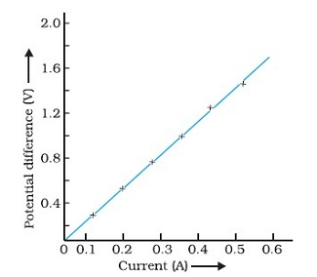
Ohmic Resistors
The line always intercepts (0,0) as V = IR, if I=0, then V=0 always.
No matter where on the line, R is constant.
Example:
R = V = rise
I run
when I = 0.2 A, then V = 0.56 V, hence R = 2.8 Ω
when I = 0.5 A, then V = 1.4 V, hence R = 2.8 Ω

Slide 52
Non-Ohmic Resistors
The line intercepts (0,0).
R is not constant. Since the line is curved the gradient is changing.

Slide 53
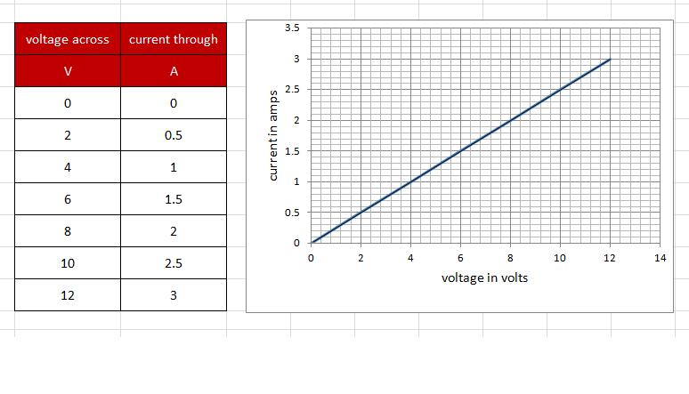
Example
Example 5.5a: Graph the following data on the graph below.
Calculate the resistance.
R = V = 2.2 – 0 = 0.25Ω
I 8.8 – 0
A
V
Voltage (V)
Current (A)

Slide 54
Homework, Context & Keywords
Context: How is this content used to better society?
The principles behind understanding the relationship of potential difference and current can help develop the transmission of information.

Slide 55
Homework, Context & Keywords
Key words:
Ohmic
Non-ohmic
Resistivity
Resistance

Slide 56
Homework, Context & Keywords
Homework:
Complete all questions from Set 5.5 - due first lesson next week.
Read Chapter 5.6 page 163-167 and answer
Q1&2 Set 5.6
by next lesson.

Slide 57
Page Setup
Set up the first page of every lesson like this and rule a column line for every page after the first page that is used during the lesson.
Focus: State the Chapter Number, Title and the page numbers (3 lines).
Keywords: During the lesson write out your own keywords used during the lesson. (8 lines)
Context: During the lesson write in this section what this topic relates to in the ‘real’ world. How is this content used to better society? (5 lines)

Slide 58
Electrical Energy and Power
Chapter 5.6 page 163-167

Slide 59
Electrical Energy
Electrical energy (work) is the potential energy transmitted or transformed when emitted from a power source. Hence;
E = V I t
E – electrical energy (J)
V – voltage (V)
I – current (A)
t – time (s)

Slide 60
Power
Power is defined as the rate of doing work or releasing energy.
P = W = I² R = V ² = V I
t R
P – power (J s⁻¹ or W)
W – work (Joules)
t – time (seconds)
V – voltage (V)
R – resistance (R)
I – current (A)

Slide 61
Power in Ohmic Resistors
P = I² R = V ²/R = VI
Example 5.6a: Calculate the power of;
A lamp with the p.d across it is 9 V and the current through it is 1.5 A.
A kettle element whose resistance is 1.2 kΩ and draws a current of 2.2 A.
P= VI = 9 x 1.5 = 13.5W
P= I² R = 2.2² x 1.2 x 10³ = 5.80 kW

Slide 62
Power in Ohmic Resistors
A lamp of resistance 12 Ω having a p.d across it of 9.0 V.
A heater of resistance 3.2 Ω connected to a 240 V supply.
A water heater working off the 240 V mains and drawing a current of 13A.
P= V² /R = 9² / 12 = 6.75 W
P= V² /R = 240² / 3.2 x 10³ = 18 W
P= VI = 240 x 13 = 3.12 kW

Slide 63
Power in Ohmic Resistors
Example 5.6b: A motor cars two headlights are each rated at 50W and operate on a 12V power supply. Calculate;
The current in each headlight
P = 50W
V = 12 V
P = V I, hence I = P = 50 = 4.17A per light
V 12
b) The charge passing through each globe every second.
I = 4.17 A
t = 1 s
q = I t = 4.17 x 1 = 4.17 C per light
c) The total energy consumed during a 2 hour journey.
P = 50 x 2 = 100 W
t = 2 x 60 x 60 = 7200 s
E = P t = 100 x 7200 = 7.2 x 10⁵ J

Slide 64
Power in Ohmic Resistors
Example 5.6c: A 1500 W electric kettle operates on a 240V power supply. Calculate;
The current of the kettle
P = 1500W
V = 240 V
P = V I, hence I = P = 1500 = 6.25 A
V 240
b) The electrical energy it uses during a standard 4.5 minute boil.
P = 1500W
t = 4.5 x 60 = 270 s
E = P t = 1500 x 270 = 4.05 x 10⁵ J
c) The total cost per boil if synergy charges 12.67 cents per kWh.
1 kWh = 10³ x 60 x 60 = 3.6 x 10⁶ J
E = 4.05 x 10⁵ J
ratio of kWh used = 4.05 x 10⁵ = 0.113
3.6 x 10⁶
cost = 0.113 x 12.67 = 1.43 cents per boil

Slide 65
Homework, Context & Keywords
Context: How is this content used to better society?
Relating power to energy in an electrical circuit to better understand the relationship of electrical flow and to produce more efficient electrical systems.

Slide 66
Homework, Context & Keywords
Key words:
Power
Energy

Slide 67
Homework, Context & Keywords
Homework:
Complete all questions from Set 5.6 - due first lesson next week.
Read Chapter 5.4 page 154-157 and answer
Q1&2 Set 5.4
by next lesson.

Slide 68
Page Setup
Set up the first page of every lesson like this and rule a column line for every page after the first page that is used during the lesson.
Focus: State the Chapter Number, Title and the page numbers (3 lines).
Keywords: During the lesson write out your own keywords used during the lesson. (8 lines)
Context: During the lesson write in this section what this topic relates to in the ‘real’ world. How is this content used to better society? (5 lines)

Slide 69
Electric Circuits
Chapter 5.4 page 154-157

Slide 70
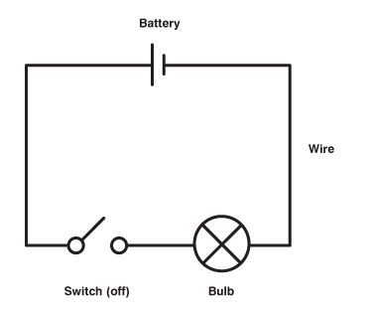
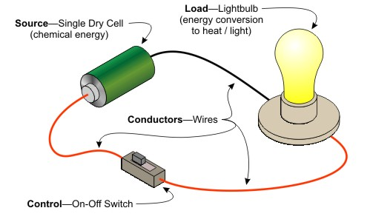
Electric Circuits
The rate of flow of electric charges, whether positive or negative is called an electric current.

Slide 71
Definitions
Voltmeter – measures the difference in electrical potential between two points in the circuit.
Ammeter – measures the flow rate of the charged electrons (flow of current).
Resistance – electricity is lost to heat (and/or sound) through the wire. The amount of heat/sound dissipated is based on the resistance the wire holds.

Slide 72
Simple Electric Circuits

Slide 73
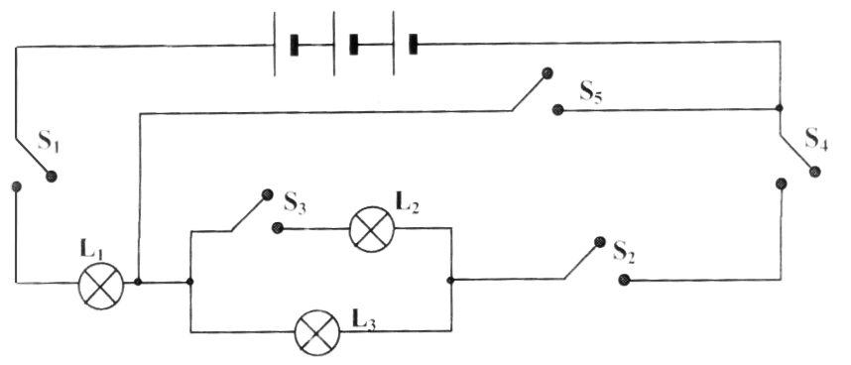
Thinking Problem
Electricity is philosophically considered to be like water. It is lazy and takes the easiest path possible. A series/parallel circuit shown contains 5 switches (S1 to S5) and 3 lamps of equal resistance (L1 to L3).
Which combination of switches that are closed would give the correct sequence of lamps that are on? [2 mark]
Answer: __________
B
 | Switches Closed | Lamps on
A | S₁, S₂, S₄ | L₁, L₂, L₃
B | S₁, S₂, S₃, S₄, S₅ | L₁
C | S₁, S₃, S₄, S₅ | L₁, L₂
D | S₁, S₂, S₃, S₄ | L₁, L₃

Slide 74
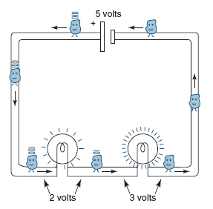
Kirchoff’s Voltage Law
The total potential drop around a closed circuit must be equal to the total EMF in the circuit. The input is provided by the voltage source V_{in} (5 volts) and the output is the voltage V_{out} (2 volts and 3 volts) across the resistors.
ΣΔV = 0

Slide 75
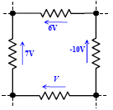
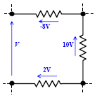
Kirchoff’s Voltage Law
Example 5.4a:
Calculate the voltage V
Solution
With an arbitrary choice of clockwise travel around the loop and counting with the voltage arrow as a positive contribution to algebraic sum, Kirchhoff’s Voltage Law:
-6 – (-10) + V +7 = 0,
so V = -11 V (voltage travels in opposite direction to arrow on diagram)
Example 5.4b:
Calculate the voltage V
Solution
Not a ‘closed circuit loop’ hence the voltage V (between the two nodes) which have nothing connected between them, should be zero. Kirchhoff’s Voltage Law is still valid. With anticlockwise travel around the loop, then:
+ V + 2 - 10 – (-8) = 0
V = 0 V

Slide 76
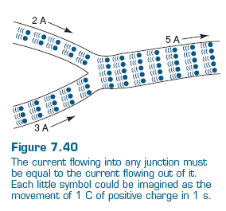
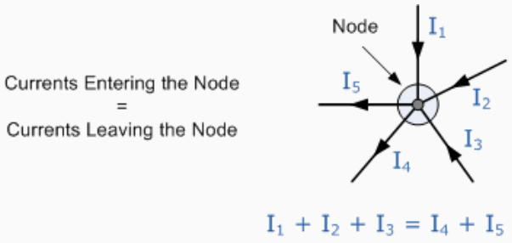
Kirchoff’s Current Law
ΣI_{in} = ΣI_{out}
In any electrical circuit the sum of all currents flowing into any point is equal to the sum of the currents flowing out of it.

Slide 77
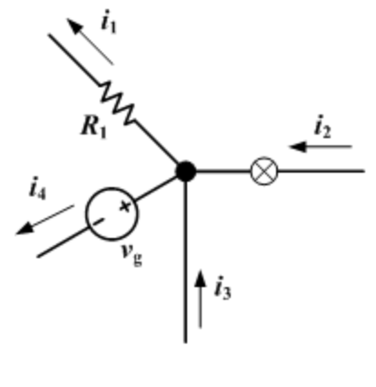
Kirchoff’s Current Law
Example 5.4c:
Calculate how much more current flows through i₁ compared to i₄, given that i₂ is twice the current of i₄ and i₃ = 4 amps.
Solution
Find i₁ given i₂ = 2 x i₄ and i₃ = 4 amps.
i₁ + i₄ = i₂ + i₃
i₁ + i₄ = 2 x i₄ + 4
i₁ = (i₄ + 4) Amps
i₁ receives 4 amps more than i₄

Slide 78
Homework, Context & Keywords
Context: How is this content used to better society?
The principles behind voltage and current can be used to produce more efficient circuitry with minimal energy wastage.

Slide 79
Homework, Context & Keywords
Key words:
Kirchoff Voltage Law
Kirchoff Current Law

Slide 80
Homework, Context & Keywords
Homework:
Complete all questions from Set 5.6 - due first lesson next week.
Read Chapter 6.1 & 6.2 page 172-185 and answer
Q1&2 Set 6.1
Q1&2 Set 6.2
by next lesson.
Chapter 5 Review questions page 169 – 170 due first lesson next week.

Slide 81
Page Setup
Set up the first page of every lesson like this and rule a column line for every page after the first page that is used during the lesson.
Focus: State the Chapter Number, Title and the page numbers (3 lines).
Keywords: During the lesson write out your own keywords used during the lesson. (8 lines)
Context: During the lesson write in this section what this topic relates to in the ‘real’ world. How is this content used to better society? (5 lines)

Slide 82
Parallel & Series Circuits
Chapter 6.1 & 6.2
pages 172-182 & pages 183-185

Slide 83
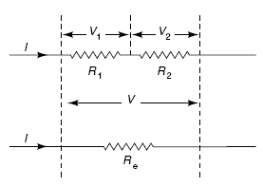
Series Circuits
V = V₁ + V₂
R_{e} = R₁ + R₂
I = I₁ = I₂

Slide 84
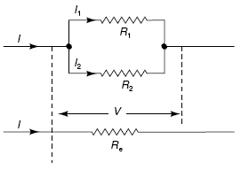
Parallel Circuits
V = V₁ = V₂
1 = ( 1 + 1 )
R_{e} R₁ R₂
I = I₁ + I₂

Slide 85
Parallel and Series Circuits
Series Circuit
V_{T} = V₁ + V₂ + V₃ + …..
R_{T} = R₁ + R₂ + R₃ + …..
I_{T} = I₁ = I₂ = I₃ = …..
Parallel Circuit
V_{T} = V₁ = V₂ = V₃ = …..
1 = 1 + 1 + 1 +
R_{T} R₁ R₂ R₃ …..
I_{T} = I₁ + I₂ + I₃ + …..
Worked Examples

Slide 86
Homework, Context & Keywords
Context: How is this content used to better society?
The principles behind voltage and current can be used to produce more efficient circuitry with minimal energy wastage.

Slide 87
Homework, Context & Keywords
Key words:
Parallel Circuits
Series Circuits

Slide 88
Homework, Context & Keywords
Homework:
Complete all questions from Set 6.1 & 6.2 - due first lesson next week.
Read Chapter 6.3 page 185-196 and answer
Q1&2 Set 6.3
by next lesson.

Slide 89
Page Setup
Set up the first page of every lesson like this and rule a column line for every page after the first page that is used during the lesson.
Focus: State the Chapter Number, Title and the page numbers (3 lines).
Keywords: During the lesson write out your own keywords used during the lesson. (8 lines)
Context: During the lesson write in this section what this topic relates to in the ‘real’ world. How is this content used to better society? (5 lines)

Slide 90
Electrical Components
Chapter 6.3 page 185-196

Slide 91
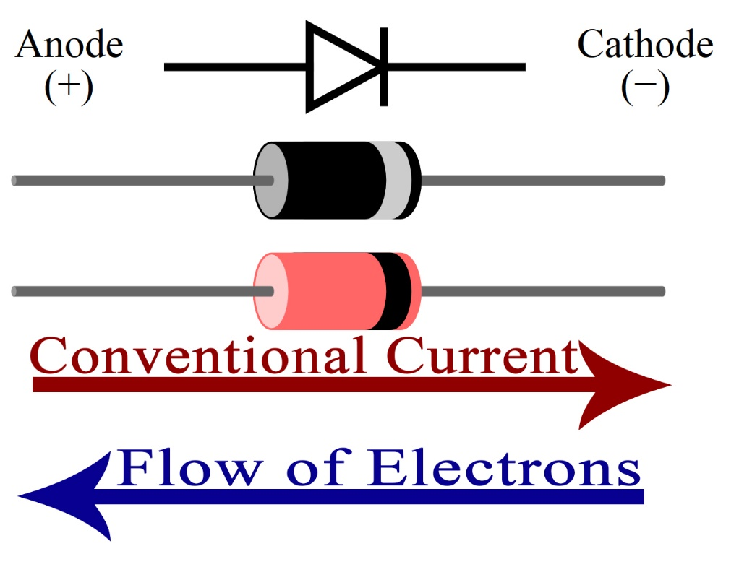
Diodes
A diode allows electricity to flow in one direction only and blocks the flow in the opposite direction (like a one-way valves) and are usually as a form of protection.
There are different types of diode but their basic functions are the same.
The arrow points in the permitted
direction of conventional flow, and
against the permitted direction of
electron flow.

Slide 92

Diodes
When placed in a simple battery-lamp circuit, the diode will either allow or prevent current through the lamp, depending on the polarity of the applied voltage.
Diode operation: (a) Current flow is permitted; the diode is forward biased. (b) Current flow is prohibited; the diode is reversed biased.

Slide 93
Transducers
A transducer is an electronic device that converts energy from one form to another. Common examples include microphones, loudspeakers, thermometers, position and pressure sensors, and antenna.
Although not generally thought of as transducers, photocells, LEDs (light-emitting diodes), and even common light bulbs are transducers.
Efficiency is an important consideration in any transducer. Transducer efficiency is defined as the ratio of the power output in the desired form to the total power input.

Slide 94
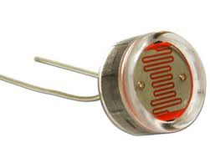
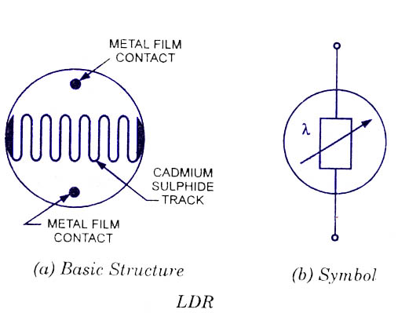

Light Dependent Resistors – LDR’s
A photoresistor or light-dependent resistor (LDR) is a light-controlled variable resistor.
The resistance of a photoresistor decreases with increasing incident light intensity; in other words, it exhibits photoconductivity.
A photoresistor can be
applied in light-sensitive
detector circuits, and
light- and dark-activated
switch circuits.

Slide 95
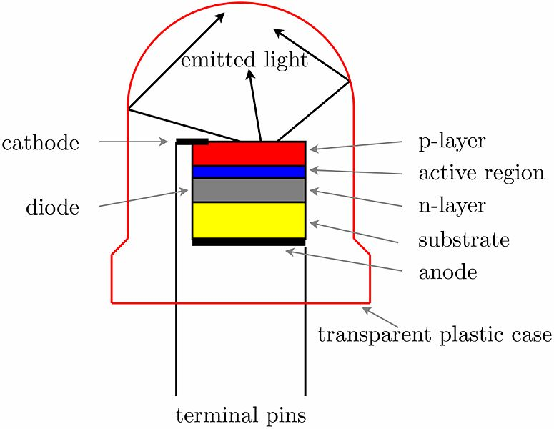
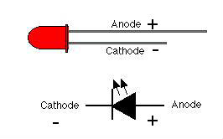
Light Emitting Diode - LED’s
An LED consists of two elements of processed material called P-type semiconductors and N-type semiconductors.
These two elements are placed in direct contact, forming a region called the P-N junction (active region).
In this respect, the LED
resembles most other
diode types, however, the
LED has a transparent
plastic case, allowing visible
light energy to
pass through.

Slide 96
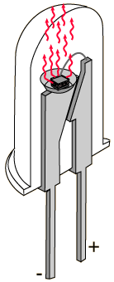
Light Emitting Diode - LED’s
LEDs operate by electroluminescence, a phenomenon in which the emission of photons is caused by electronic excitation of a material.
The material used most often in LEDs is gallium arsenide.
Among other things, they form numbers on
digital clocks, transmit information from remote
controls, light up watches and tell you when your
appliances are turned on. Collected together,
they can form images on a jumbo television
screen or illuminate a traffic light.

Slide 97


Thermistors
A thermistor is a thermal resistor - a resistor that changes its resistance with temperature.
Technically, all resistors are thermistors - their resistance changes slightly with temperature - but the change is usually very very small and difficult to measure. Thermistors are made so that the resistance changes drastically with temperature so that it can be 100 ohms or more of change per degree.

Slide 98

Thermistors
There are two kinds of thermistors,
negative temperature coefficient (NTC) and
positive temperature coefficient (PTC).
In general, you will see NTC sensors used for temperature measurement. PTC's are often used as resettable fuses - an increase in temperature increases the resistance which means that as more current passes through them, they heat up and 'choke back' the current; a good way for protecting circuits.

Slide 99
Thermistors
Since the negative temperature coefficient of silver sulphide was first observed by Michael Faraday in 1833, there has been a continual improvement in thermistor technology.
The most important characteristic of a thermistor is, without question, its extremely high temperature coefficient of resistance.
Modern thermistor technology results in the production of devices with extremely precise resistance versus temperature characteristics, making them the most advantageous sensor for a wide variety of applications.

Slide 100

Photodiodes
A photodiode is a semiconductor device that converts light into current. The current is generated when photons are absorbed in the photodiode. A small amount of current is also produced when no light is present. Photodiodes may contain optical filters, built-in lenses, and may have large or small surface areas. Photodiodes usually
have a slower response time as its
surface area increases. The
common, traditional solar cell used
to generate electric solar power is
a large area photodiode.

Slide 101


Photodiodes
When a photon of sufficient energy strikes the diode, it excites an electron, thereby creating a free electron and a (positively charged) hole. Thus holes move toward the anode, and electrons toward the cathode, and a photocurrent is produced.

Slide 102
Homework, Context & Keywords
Context: How is this content used to better society?
To analyse the principles and uses of existing electrical components to advance electrical technology.

Slide 103
Homework, Context & Keywords
Key words:
Diodes
Transducers
LDR’s (Light Dependent Resistors)
LED’s (Light Emitting Diode)
Thermistors
Photodiodes

Slide 104
Homework, Context & Keywords
Homework:
Complete all questions from Set 6.3 - due first lesson next week.
Read Chapter 6.4 page 197-200 and answer
Q1 Set 6.4
by next lesson.

Slide 105
Page Setup
Set up the first page of every lesson like this and rule a column line for every page after the first page that is used during the lesson.
Focus: State the Chapter Number, Title and the page numbers (3 lines).
Keywords: During the lesson write out your own keywords used during the lesson. (8 lines)
Context: During the lesson write in this section what this topic relates to in the ‘real’ world. How is this content used to better society? (5 lines)

Slide 106
Household Electricity
Chapter 6.4 page 197-200

Slide 107


Fuse
A fuse is a type of low resistance resistor
that acts as a sacrificial device to provide
overcurrent protection. Its essential
component is a metal wire or strip that
melts when too much current flows through it, interrupting the circuit that it connects.
Short circuits, overloading, mismatched loads, or device failure are the prime reasons for excessive current.
Fuses are an alternative to
circuit breakers.

Slide 108

Residual Current Device - RCD
Residual current devices (RCDs), commonly referred to as ‘safety switches’, are electrical safety devices designed to immediately switch off the supply of electricity when electricity leaking to earth is detected.
A residual-current device (RCD) is an electrical wiring device that disconnects a circuit whenever it detects that the electric current is not
balanced between the energised
conductor and the return neutral
conductor.

Slide 109


Residual Current Device - RCD
Such an imbalance may indicate current leakage through the body of a person who is grounded and accidentally touching the energised part of the circuit. A lethal shock can result from these conditions. RCD’s are designed to disconnect quickly enough to prevent
injury caused by such shocks. They are
not intended to provide protection
against overcurrent (overload) or all
short-circuit
conditions.

Slide 110


Double Insulation
Wires are double insulated to ensure accidental cutting of the outer sheath does not expose the wires to human contact.
Some appliances have double insulation. These appliances only need live and neutral wires. They do not need an earth wire.
An appliance that is double insulated has the whole of the inside contained in plastic, underneath an outer casing. If anything goes wrong with the appliance, no live conductor can touch the outer casing because of the insulating
plastic.

Slide 111

Short Circuit
A short circuit is an electrical circuit that allows a current to travel along an unintended path, often where essentially no or a very low resistance is encountered.
The electrical opposite of a short circuit is an "open circuit", which is an infinite resistance between two nodes.
A short circuit can damage
the circuit by overheating.

Slide 112
Homework, Context & Keywords
Context: How is this content used to better society?
To analyse the principles and uses of existing safety components to advance electrical technology in a safe environment.

Slide 113
Homework, Context & Keywords
Key words:
Fuse
RCD (Residual Current Device)
Double Insulation
Short Circuit

Slide 114
Homework, Context & Keywords
Homework:
Complete all questions from Set 6.4 - due first lesson next week.
Read Chapter 1.1 page 4-9 and answer
Q1&2 Set 1.1
by next lesson.
Chapter 6 Review questions page 201 – 203 due first lesson next week.

Slide 115
Household Electrical Design
Draw a basic house plan and allocate certain appliances to each room. Students draw up the wiring diagram based on voltage, current and power outputs in each room.

